Slide 1


Blood Bank
Vincent Gonzalez

Slide 2

Background
This program is being undertaken by the American Red Cross. They need an application to measure which types of blood that are currently in storage and which they are short in stock.
This application will keep track of donor’s information, their blood type, and when they can donate.

Slide 3

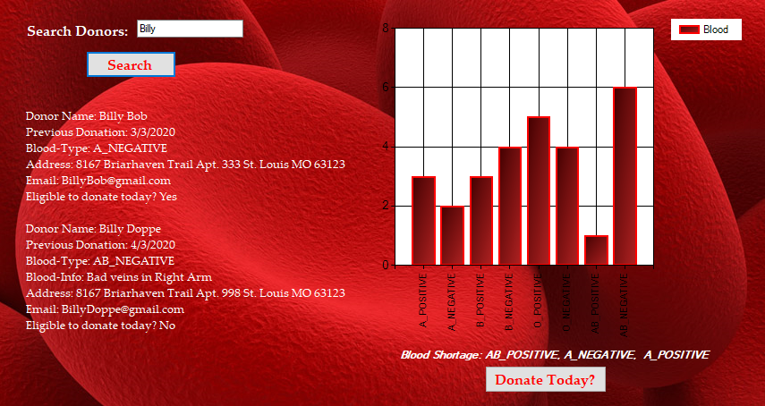
Key Features
Register New Users
Store Data
- (Blood types, donor’s name, address, telephone number, donation date)
Retrieve Data through Search
- Pull Data about Donor
Ability to Contact donor when they can donate again from last donation date
Display amounts of different blood types currently in storage
- Graph on Employee Login

Slide 4
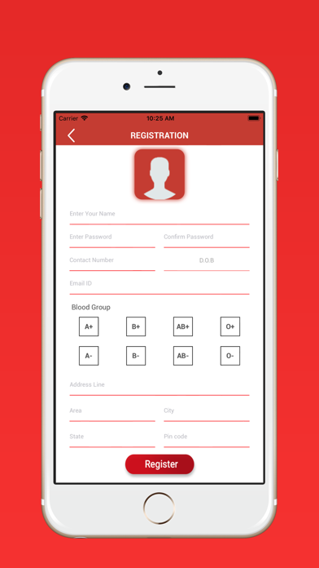
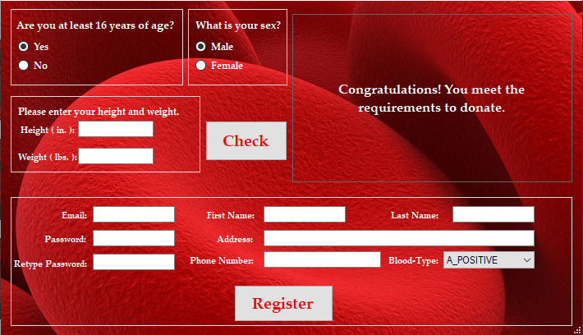
Similar Application Comparison

